Slide 1
Deploying java APPLICATION USING Jenkins pipeline
Project-5
DEEPTHI YETURI

Slide 2
CONTENTS
Introduction
Prerequisites
SSH agent plugin
Deploy Java web-calculator app in tomcat using pipeline

Slide 3
JENKINS
JENKINS:
Jenkins is an open source automation server. It helps automate the parts of software development related to building, testing, and deploying, facilitating continuous integration and continuous delivery.
TYPES OF JOBS IN JENKINS:
Free style
Maven project
Multi configuration project
Pipeline
Multi branch pipeline

Slide 4
JENKINS PIPELINE
Jenkins pipeline is a group of events or jobs which are interlinked with one another in a sequence. A pipeline code defines the entire build process, which typically includes stages for building an application, testing it and then by delivering it

Slide 5
TOMCAT
Tomcat is an open source web server developed by the Apache Software Foundation. It is a popular choice for web applications due to its scalability, reliability, and performance. Tomcat is a Java servlet container and web server that provides a platform for Java-based web applications.
SSH AGENT
SSH Agent acts as a secure key management system. It runs in the background and stores your private keys in memory while your SSH session is active

Slide 6
DEPLOY WEB-CALCULATOR IN TOMCAT USING JENKINS
STEPS:
Add maven tool
Install ssh-agent plugin
Configure ssh-agent
Create a pipe line job
In pipeline add groovy script
Save the job
Build
Browse public ip of tomcat server:8080/webapp-0.1

Slide 7
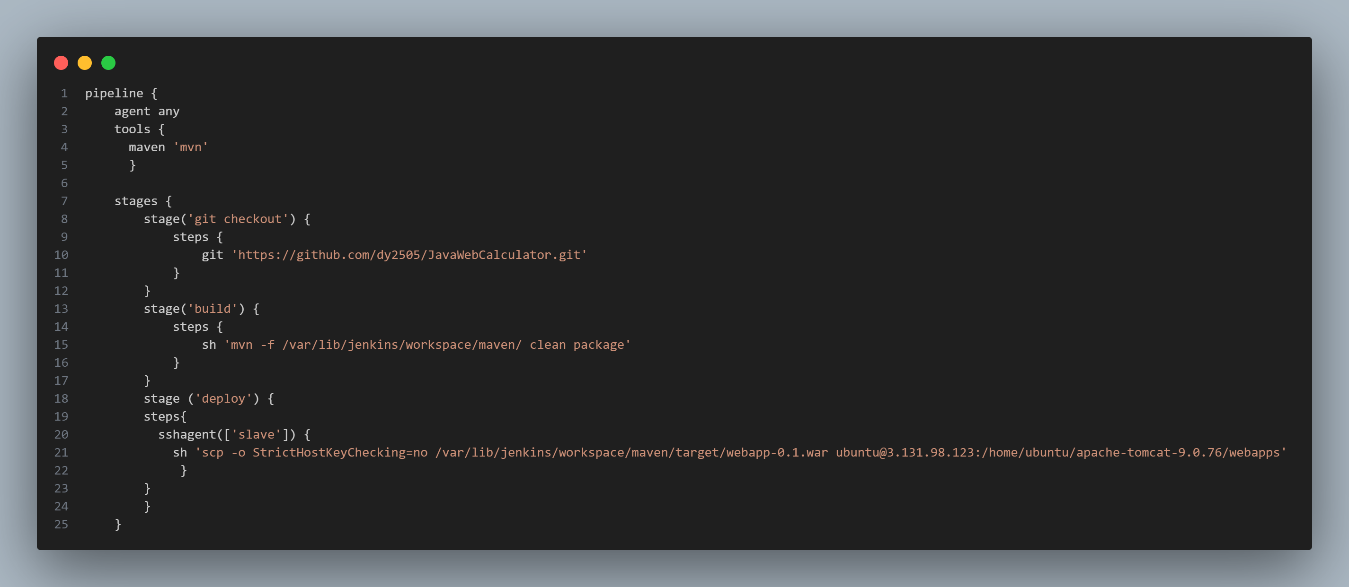
GROOVY SCRIPT

Slide 8


